Slide 1
SCS 101 introduction to computer programming Lect. 4
PROGRAMMING PRACTICES AND STYLES
Good programming practices
1. Use of comments-comments are non-executable statements in a program that tries to tell what part of the program is doing or give the name(author of the program, date of creation or explain a block, a single statement, a function or intended purpose)
Advantages of using comments
The program is easily understood (readability)
It makes the modification of a program more easier in future
Two types of comments
i. Single line comment (//)-its used when commenting using one line
e.g //My first program in C
ii. Multiple line comment(/*--------------------------------
---*/)
Its used when commenting on multiple or many lines also known as block comment e.g
/*Program to calculate the total,
and average of 5 units*/

Slide 2
Best practice
2. Braces({ })-The opening and closing braces. All braces must be opened and must be closed.
3. Whitespace-it refers to character in programming e.g tabs, newlines e.t.c
4. Indenting-It refers to moving away from the margin
5. Escape sequence-These are programming shortcuts that are used when writing codes and they perform a certain task.
Each is represented by a backslash followed by an escape character

Slide 3
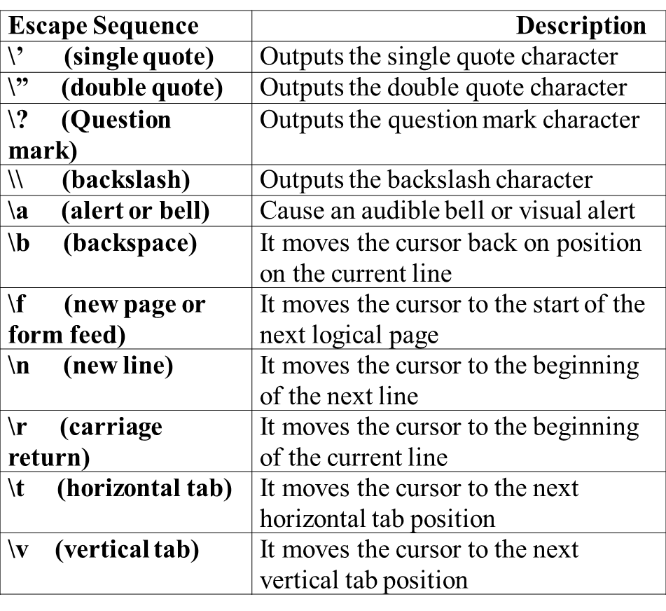
Escape sequence characters

Slide 4
STRUCTURE OF A PROGRAM
#include<stdio.h>//pre-processor directive
Int main()
{
//my first C program
Printf(“My first program\n”);
Return 0;/*program end successfully*/
}

Slide 5
Structure of a C program
Documentation section-it consists of comments giving the title of the program, the author, the date of creation, the aim or objectives of the program.
The compile directive-It provides instructions to the compiler to link the functions to its system library e.g #include<stdio.h>,#include<math.h>.#include<stdlib.h>
Main function-It indicates the start of execution or the program statement. The main function is used to call any other program in the body of a program and is executable in a sequential manner. A function is a small program that carries out a specific task when called
Body of the program-It consists of opening and closing braces.
Declaration of variables-All variables must be declared before use.
Return 0-This means terminating a function, it puts an end to execution of a program. It returns the control to the operating system

Slide 6
IDENTIFIERS
In C programming, identifiers are names given to C entities, such as variables, functions, structures etc.
Identifier are created to give unique name to C entities to identify it during the execution of program.
It’s a name given to a variable, constant or a function.
Rules for naming identifiers
It must/should not be a reserved word or keyword
It should always start with an alphabet
It should not contain special characters
It can contain alphabets, numerically i.e alphanumeric
Should be upto 256 characters
Note: C is case sensitive
Keywords-These are used within specific programming language and cant change(inbuilt)e.g scanf, printf, int ,main e.t.c

Slide 7
Variable
These are programming concepts that are memory locations which stores a value that are determined to change with different executions.
Variable declaration
All variables must be declared before use
General syntax:
Data type variable_name
Data type
C data types are defined as the data storage format that a variable can store a data to perform a specific operation.
Data types are used to define a variable before to use in a
program.
Size of variable, constant and array are determined by data types.

Slide 8
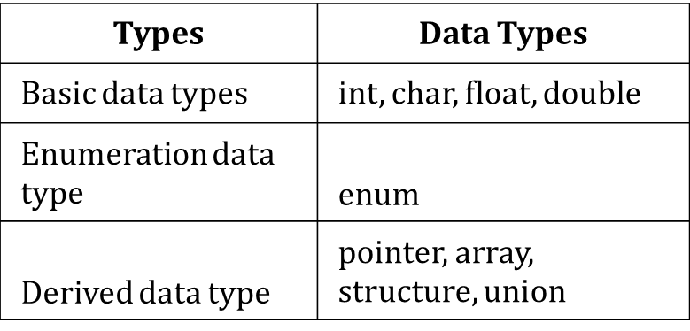

Data types
There are four data types in C language. They are;

Slide 9
Basic data types in C language
1. INTEGER DATA TYPE:
Integer data type allows a variable to store numeric values.
“int” keyword is used to refer integer data type.
The storage size of int data type is 2 or 4 or 8 byte.
It varies depending upon the processor in the CPU that we use. If we are using 16 bit processor, 2 byte (16 bit) of memory will be allocated for int data type.
Like wise, 4 byte (32 bit) of memory for 32 bit processor and 8 byte (64 bit) of memory for 64 bit processor is allocated for int datatype.
int (2 byte) can store values from -32,768 to +32,767
int (4 byte) can store values from -2,147,483,648 to
+2,147,483,647.

Slide 10
Integer data type
If you want to use the integer value that crosses the above limit, you can go for “long int” and “long long int” for which the limits are very high.
Note:
We can’t store decimal values using int data type.
If we use int data type to store decimal values, decimal values will be truncated and we will get only whole number.
In this case, float data type can be used to store decimal values in a variable.

Slide 11
2. Character data type
Character data type allows a variable to store only one character.
Storage size of character data type is 1. We can store only one character using character data type
“char” keyword is used to refer character data type.
For example, ‘A’ can be stored using char datatype. You can’t store more than one character using char data type.
Please refer C – Strings topic to know how to store more than one characters in a variable.

Slide 12
3. FLOATING POINT DATA TYPE
Floating point data type consists of 2 types. They are;
Float
Double
1. FLOAT:
Float data type allows a variable to store decimal values.
Storage size of float data type is 4. This also varies depend
upon the processor in the CPU as “int” data type.
We can use up-to 6 digits after decimal using float data type. For example, 10.456789 can be stored in a variable using float data type

Slide 13
2. DOUBLE
Double data type is also same as float data type which allows up-to 10 digits after decimal.
The range for double datatype is from 1E–37 to 1E+37.
SIZEOF() FUNCTION IN C LANGUAGE:
sizeof() function is used to find the memory space allocated for each C data types.

Slide 14
Example of sizeof() program
#include <stdio.h>
#include <limits.h>
int main()
{
int a; char b; float c; double d;
printf("Storage size for int data type:%d \n",sizeof(a));
printf("Storage size for char data type:%d \n",sizeof(b));
printf("Storage size for float data type:%d \n",sizeof(c));
printf("Storage size for double data type:%d\n",sizeof(d));
return 0;
}

Slide 15
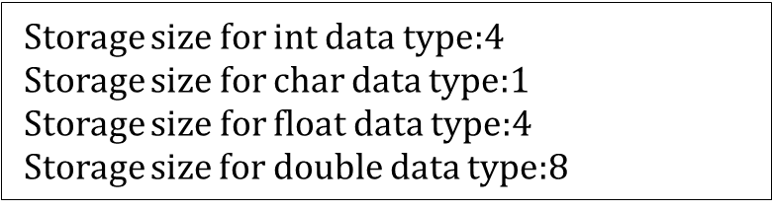
OUTPUT

Slide 16
Modifiers in C language
The amount of memory space to be allocated for a variable is derived by modifiers.
Modifiers are prefixed with basic data types to modify (either increase or decrease) the amount of storage space allocated to a variable.

Slide 17
Modifiers in C language
For example, storage space for int data type is 4 byte for 32 bit processor. We can increase the range by using long int which is 8 byte. We can decrease the range by using short int which is 2 byte.
There are 5 modifiers available in C language. They are;
short
long
signed
unsigned
long long
Below table gives the detail about the storage size of each C basic data type in 16 bit processor. Please keep in mind that storage size and range for int and float datatype will vary depend on the CPU processor (8,16, 32 and 64 bit)

Slide 18
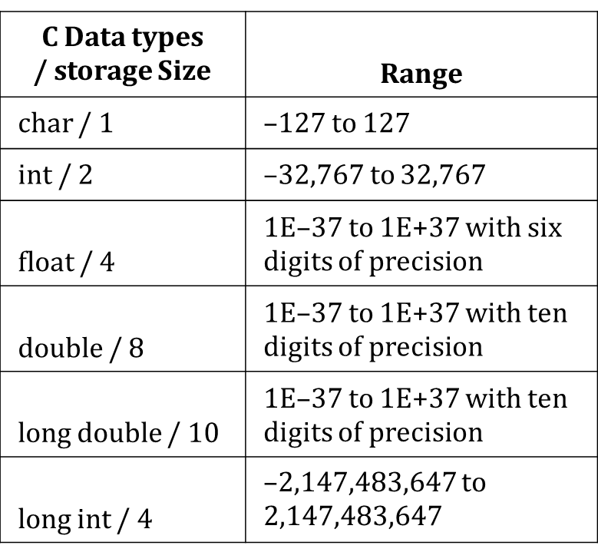
Modifiers table

Slide 19
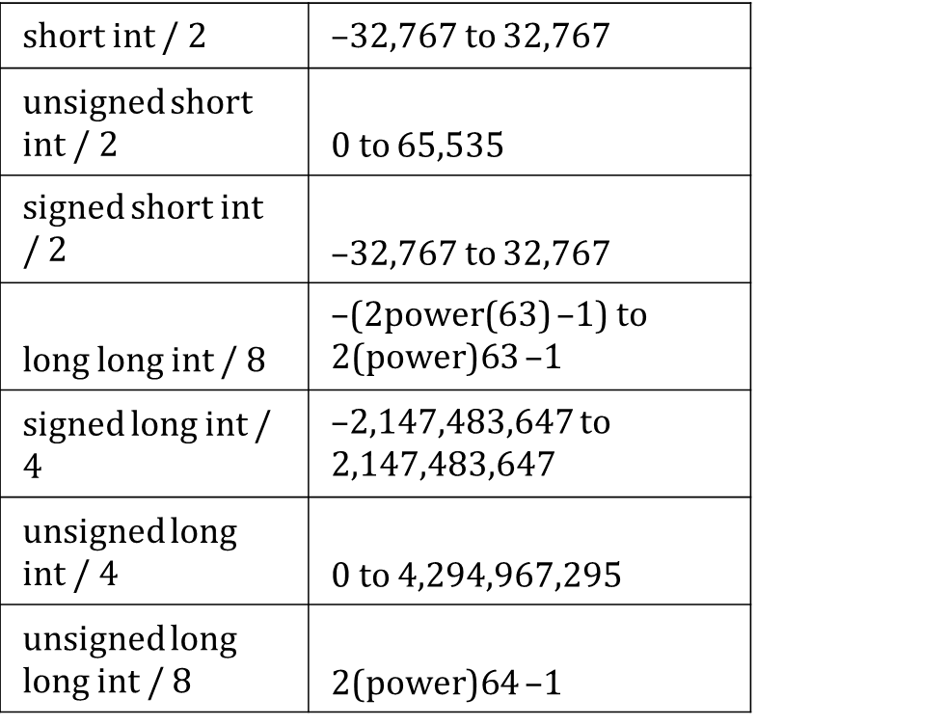
Modifiers cont.

Slide 20
2. Enumeration data type
Enumeration data type consists of named integer constants as a list.
It start with 0 (zero) by default and value is incremented by 1 for the sequential identifiers in the list.
Enum syntax in C:
enum identifier [optional{ enumerator-list }];
Enum example in C:
Enum month{Jan, Feb, Mar};
/* Jan, Feb and Mar variables will be assigned to 0, 1 and 2 respectively OR
Enum month {Jan=1, Feb, Mar};
/* Feb and Mar will be assigned 2 and 3 respectively by default */
Enum month {Jan=20, Feb, Mar};
/*Jan is assigned 20, Feb is 21 while Mar is 22 respectively by default*/

Slide 21
Define
The above enum functionality can also be implemented by “#define” preprocessor directive as given below. Above enum example is same as given below.
Define Jan=20;
Define Feb=21;
Define Mar=22

Slide 22
Example of ENUM program
#include <stdio.h>
int main()
{
enum MONTH { Jan = 0, Feb, Mar };
enum MONTH month = Mar;
if(month == 0)
printf("Value of Jan");
else if(month == 1)
printf("Month is Feb");
if(month == 2)
printf("Month is Mar"); 12 }

Slide 23
DERIVED AND VOID DATA TYPE
DERIVED DATA TYPE
Include Array, pointer, structure and union
“Array” , “C – Pointer” , “C – Structure” and “C – Union” topics will be covered in detail later.
VOID DATA TYPE IN C LANGUAGE:
Void is an empty data type that has no value.
This can be used in functions and pointers.
This will be covered in “C – Function” topic.

Slide 24
VARIABLE DECLARATION
Variable declaration tells the computer to allocate memory for the variables of the given data type.
Variables can be declared into two cases:
1. After the opening brace of a block of code(usually at the top of the function)
2. Before a function name(such as before main()in the program)
Scope of variables
a. Global variables-these are variables which are used in the whole program. They are declared before the main function
Example
#include<stdio.h>
int marks;//Global variable
int main()
{
}

Slide 25
Variables
b. Local variables-the scope is limited to a block of codes enclosed in braces
Example
#include<stdio.h>
int main()
{
Int marks;//local variable
}

Slide 26
Initializing variables
Syntax:
Datatype variable_name=value
To initialize a variable is to assign a value to a variable e.g int marks=76;
Example
This program will read two numbers from user and calculate sum and average of numbers.
/* c program find sum and average of two numbers*/
#include <stdio.h>
int main()
{
int a,b,sum; float avg;
printf("Enter first number :");
scanf("%d", &a);

Slide 27
printf("Enter second number :");
scanf("%d",&b);
sum=a+b;
avg= (float)(a+b)/2;
printf("\nSum of %d and %d is = %d",a,b,sum);
printf("\nAverage of %d and %d is = %f",a,b,avg);
return 0;

Slide 28
Constants
This is a memory location that stores values which are not determined to change
Constants are the terms that can't be changed during the execution of a program. e.g pie=3.142 Declaration of constants
There are two ways of declaring constants;
Before the main function-We use the #define followed by the constant name and the value
Syntax:
#define constant_name value
Example
#include<stdio.h>
#define pie 3.142
Int main()
{
}

Slide 29
Constants
b. After the main function
Syntax:
Const datatype constant_name=value
Example
#include<stdio.h> Int main()
{
Const double pie=3.14
}
Reasons for using constants
1. Makes a program easier to read and modify
2. Reduces repetition of codes

